Slide 1



IOT BASED FAULT IDENTIFY FOR AGED PEOPLE

Slide 2
TEAM MEMBERS:
SRUTHIKAA KV(927621BEC212)
YUVA SHREE R(927621BEC252)
SOWMIGA B(927621BEC207)
SUGANYA DEVI S(927621BEC220)
GUIDED BY:
Mrs.SENTAMILSELVI M(AP/ECE)

Slide 3
INTRODUCTION:
IoT-based fault identification systems for the elderly are innovative solutions leveraging Internet of Things (IoT) technology to enhance the safety and well-being of aging individuals. These systems employ sensors and data analytics to monitor seniors' daily activities, detect falls, health emergencies, and deviations from routines, and send alerts to caregivers or healthcare professionals when anomalies occur. With a growing aging population, these systems provide timely assistance, reduce healthcare costs, and offer peace of mind to families.IoT-based fault identification represents a vital step toward enabling seniors to live independently while ensuring rapid response to their needs.

Slide 4
ABSTRACT:
The aging global population presents a pressing challenge in healthcare and elderly care. In response, Internet of Things (IoT) technology is increasingly deployed to create fault identification systems tailored to the needs of aged individuals. These IoT-based systems continuously monitor the well-being of seniors, utilizing an array of sensors and data analytics to detect anomalies or faults in real-time. This paper explores the architecture, components, and benefits of IoT-based fault identification solutions for the elderly, emphasizing timely response to falls, medical emergencies, and deviations from daily routines. In summary, IoT-based fault identification for aged people represents a transformative approach to elderly care, offering enhanced safety, independence, and peace of mind for both seniors and their caregivers.

Slide 5
PROBLEM STATEMENT:
Balancing Autonomy and Safety: Striking the right balance between preserving the independence and privacy of the elderly and implementing monitoring solutions to provide timely assistance in case of faults or emergencies.
Timely Response to Elderly Emergencies: Developing an IoT-based system to swiftly detect and respond to falls, health issues, and deviations from routines among the aging population while ensuring privacy and data security.

Slide 6
OBJECTIVE:
Enhanced Safety: To leverage IoT technology for continuous monitoring and early detection of faults, such as falls or health emergencies, to ensure the safety of the elderly.
Improved Quality of Life: To enable aging individuals to maintain their independence and quality of life by providing timely assistance and healthcare support when required.

Slide 7
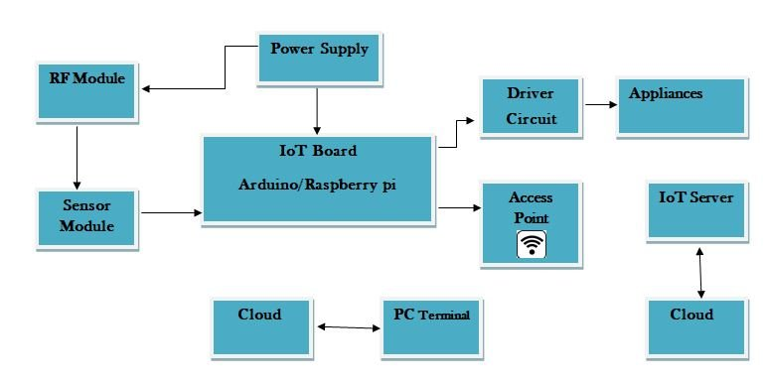
BLOCK DIAGRAM:

Slide 8
EXISTING SYSTEM:
Existing IoT-based fault identification systems for the elderly typically involve wearable sensors and data analysis to detect falls, health anomalies, and deviations from routines, providing timely alerts to caregivers and healthcare providers. These systems aim to enhance elderly safety and independence.

Slide 9
PROPOSED SYSTEM:
The proposed IoT-based fault identification system for aged people will integrate advanced machine learning algorithms with wearable and environmental sensors to provide real-time fault detection, rapid response, and personalized healthcare support, enhancing seniors' safety and well-being.

Slide 10
COMPARISON(with existing system)
The proposed IoT-based fault identification system offers advanced machine learning integration and personalized healthcare support, potentially improving accuracy and responsiveness compared to existing systems. However, ensuring cost-effectiveness, user-friendliness, and robust privacy measures will be crucial for successful adoption, as similar challenges exist in both the proposed and existing systems.

Slide 11
CONCLUSION:
IoT-based fault identification systems for the elderly offer a transformative approach to aging care, providing real-time monitoring and timely response to health emergencies and accidents. These systems promote independence, enhance safety, and improve the overall quality of life for seniors, with a focus on privacy and cost-effectiveness as key considerations for successful implementation. As the aging population continues to rise, the significance of such technology in elderly care cannot be overstated.

Slide 12
MODULES:
Position detection sensor
Nodemcu
Alarm
Wifimodule

Slide 13
REFERENCE:
[1]R. Isermann, Fault-Diagnosis Systems, Springer, Berlin, 2006
[2] R. Isermann,“Model-Based Fault Detection And Diagnosis-Status And Applications”, Annual Reviews in Control, Vol. 29, Is. 1, 2005
[3] R. Isermann, "Process Fault Detection Based on Modeling and Estimation Methods–A Survey”, Automatica, Vol. 20, No. 4, 1984
[4] I. Castillo and T. Edgar, “Model Based Fault Detection and Diagnosis”, TWCCC Conference, Spring 2008, Austin, Texas
[5] V. Venkatasubramanian, R. Rengaswamy, S. N. Kavuri and K. Yin, “A review of process fault detection and diagnosis Part I: Quantiative model-based methods”, Computers and Chemical Engineering, No. 27, 2003

